Slide 1
Tableau Homework - Citi Bike Analytics This analysis is based on the Summer 2019 routes
Ken Ho
Nov 23, 2020

Slide 2
This analysis is based on the Summer2019 routes
_____trips have been recorded during the summer of 2019
How many trips have been recorded total during the chosen period?
* By what percentage has total ridership grown?
* How has the proportion of short-term customers and annual subscribers changed?
* What are the peak hours in which bikes are used during summer months?

Slide 3
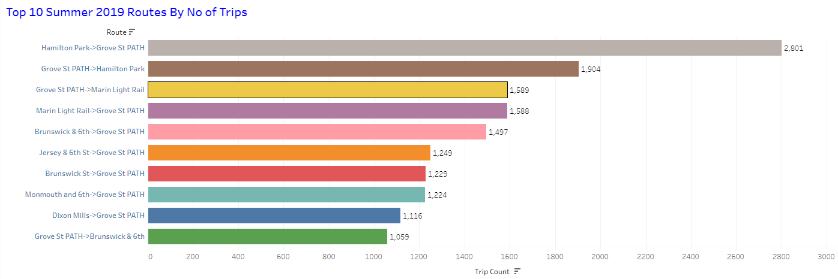
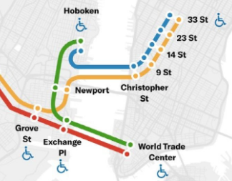
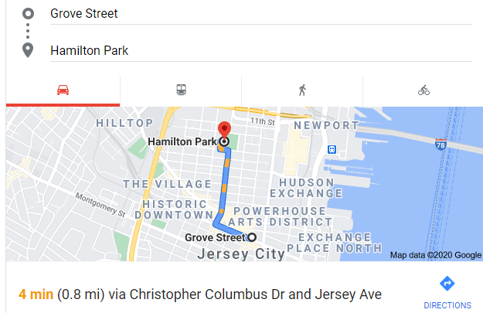
The top 10 routes based on the number of trips are shown above. Compared to the tenth, the highest station has about 1,742 more trips or 20 trips per day
Our data shows that the top two routes are the Hamilton Park to Grove Street PATH Station and return trip. These two stations are about 0.8 miles from each other in Jersey City. The PATH Train from Grove Street is on a popular commute route to the World Trade Center in New York City. Grove Street PATH also runs on another line up north to New York City’s 33rd Street Station. This is the Fashion District and also where Macy’s is located. From here, it is a short walk to New York City’s Penn Station where the Long Island Railroad originates. A 15-minute walk further north is Grand Central Station, another critical commuter hub. These are why the two routes are the top ones for Citi bikes in Jersey City
The top two routes of Hamilton Park and Grove Street PATH Station also has the largest number of bicycle docks (12 each) and hence bicycle availability in the neighborhood

Slide 4
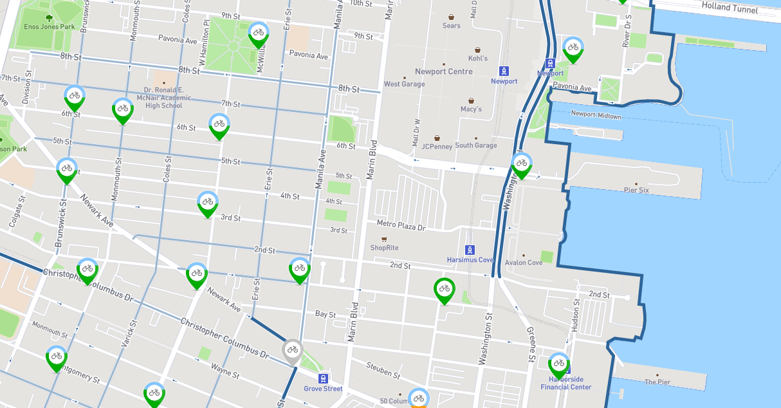
Brunswick & 6th
Hamilton Park
Jersey City, NJ
All of the top 10 routes have Grove Street PATH Station as either a starting or ending station
Bottom stations such as Brunswick & 6th are further away from the major commuting hub such as Grove Street PATH Station and they are also in less populated and busy neighborhoods. Additionally they also has the least number of docks and hence bicycles available
The top 10 routes are located around the Jersey City area

Slide 5
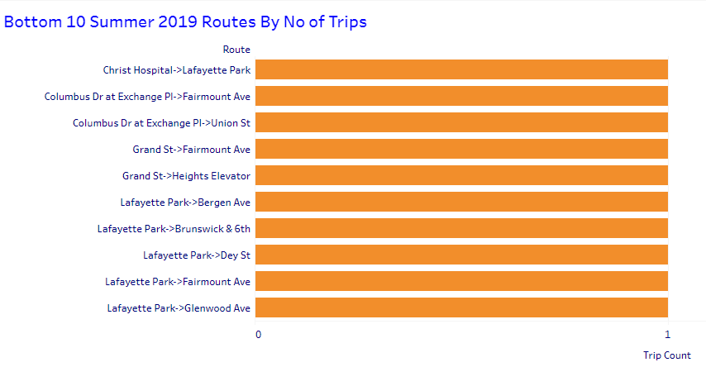
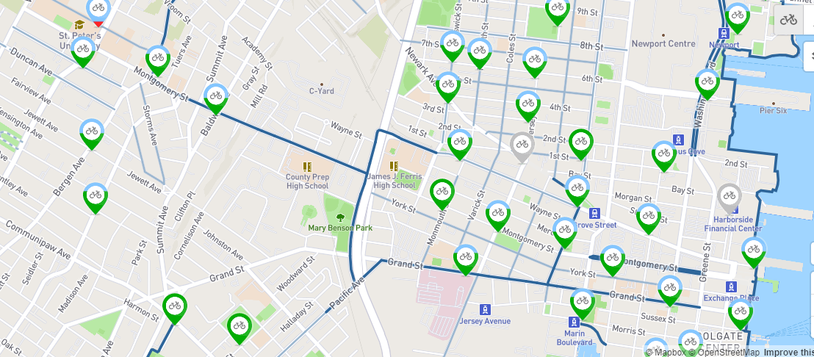
Fairmount Ave
Lafayette Park
Bottom 10 routes are such because they are located further away from the busy areas
Grove Street PATH Station
Busy areas with high bike usage

Slide 6
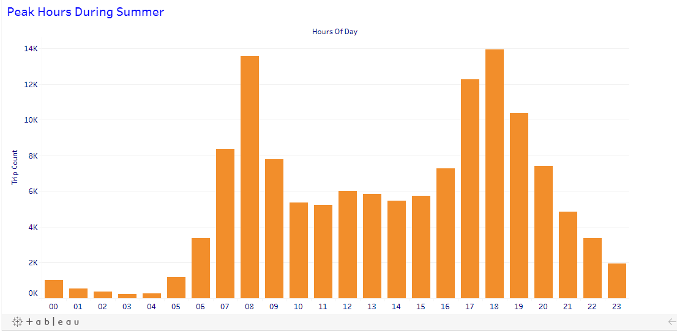
Peak usage times are at 8 AM in the morning and 6 PM in the evening, corresponding to the office rush hours
Peak usage times align with the top 10 stations where the Grove Street PATH Station is either the starting or ending point

Slide 7
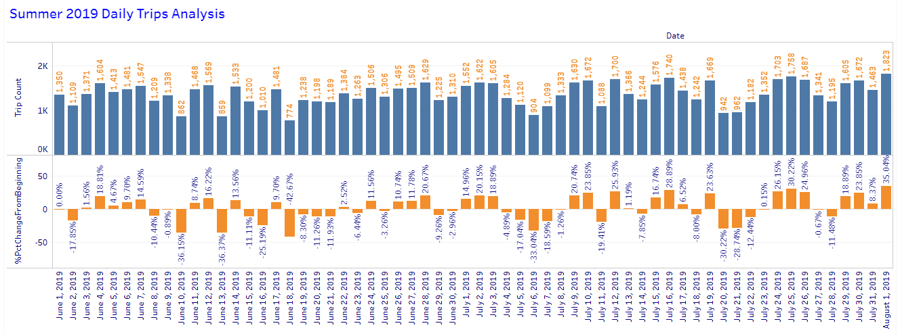
Other than the Weekends, usage appear steady during the summer of 2019
Holiday Weekend sees lower trip usage
In July the Weekend sees noticeably lower trip usage
Highest day of usage

Slide 8
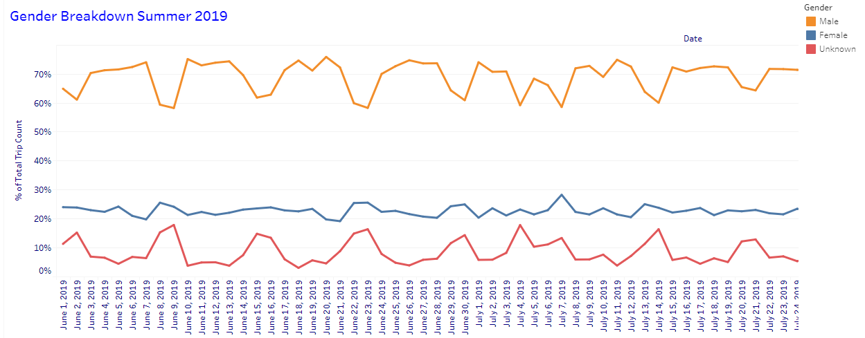
Over the summer of 2019, male riders average about 65% of the population of riders. Females are 25%. Unknown gender are about 10%
The male riders show a distinct pattern of lower usage on the weekends
Unknown gender use the bikes on often on weekends. These are likely casual users who do not take the extra trouble to register their gender information carefully when renting a bike

Slide 9
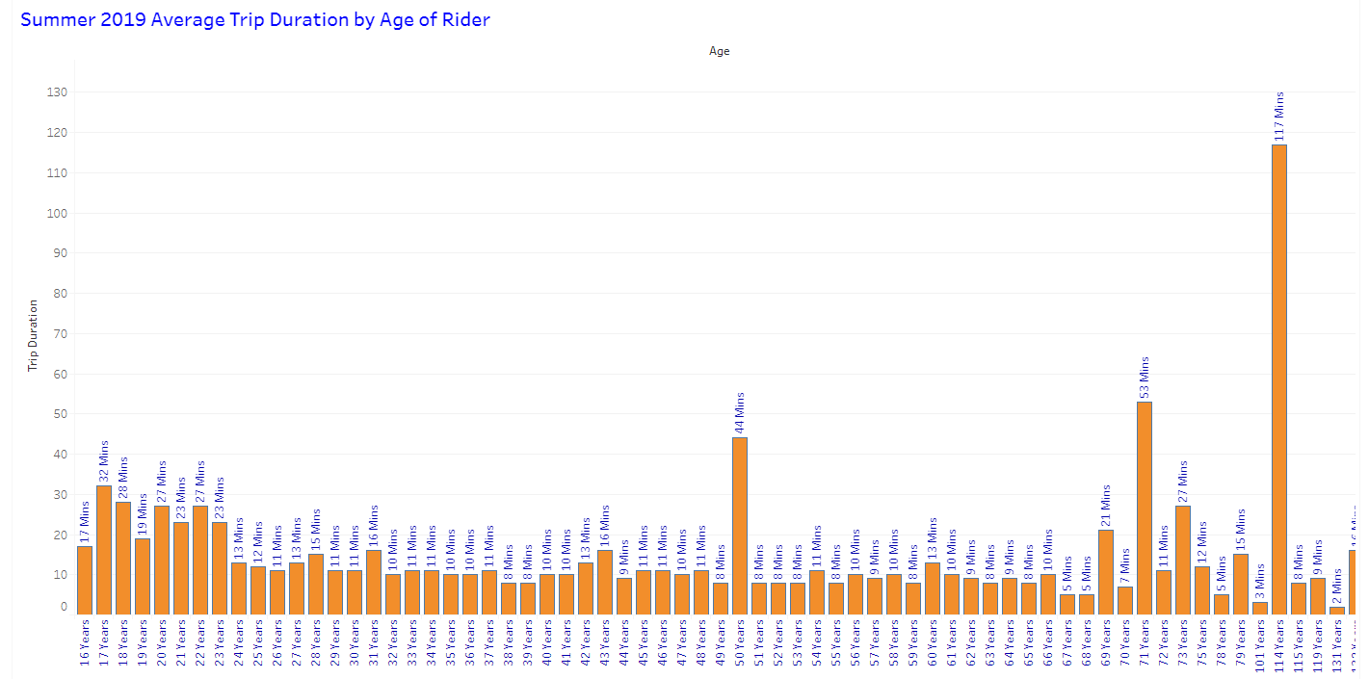
remove from analysis
outlier; unexpected phenomena
outlier; unexpected phenomena

Slide 10
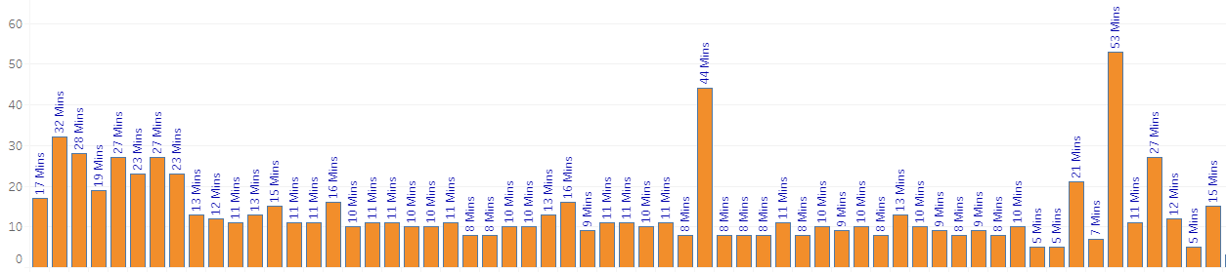
outlier; unexpected phenomena
outlier; unexpected phenomena
17 to 23
24 to 37
38 to 48
49 to 68
Age group of 16 years has an average trip duration of 17 minutes
The age group of 17 to 23 years has an average trip duration of 26 minutes
As the age increase beyond 23, the average trip duration seem to decrease with age increase
The age group of 23 to 37 years has an average trip duration of 12 minutes
We measured an average trip duration of 10 minutes for the age group of 38 to 48 years
The age group of 49 to 68 years has an average trip duration of 8 minutes

Slide 11
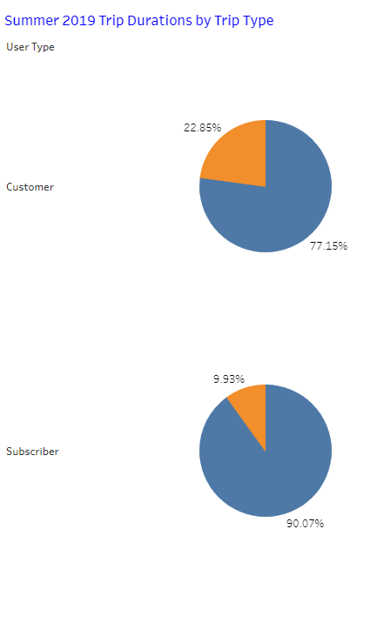

Subscribers are those who join the Citi bike membership and use the bicycles more frequently for all kinds of purposes. Therefore, they are less likely than Customers to return the bicycles to the same stations
Customers use the bicycles less frequently and usually need the bicycles when they leave a station and need to run a quick errand and usually return the bicycle to the same station when they complete that errand

Slide 12
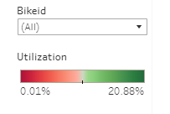
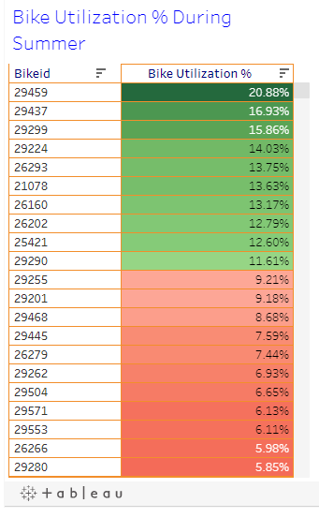
Which bikes (by ID) are most likely due for repair or inspection in the timespan (summer 2019)?
These 10 bikes (all above 10% of utilization) are likely needed for maintenance
Utilization was calculated for each bike ID using its the total time used (in seconds) as a percentage of the total period (in seconds) of the entire summer of 2019

Slide 13
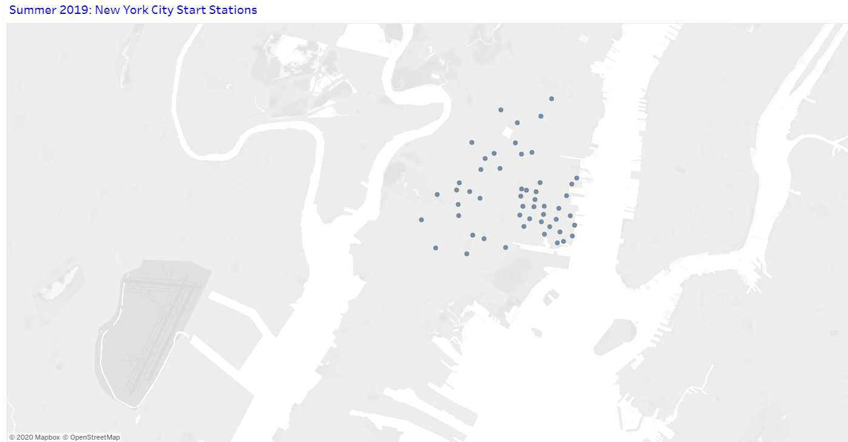
City Official Map

Slide 14
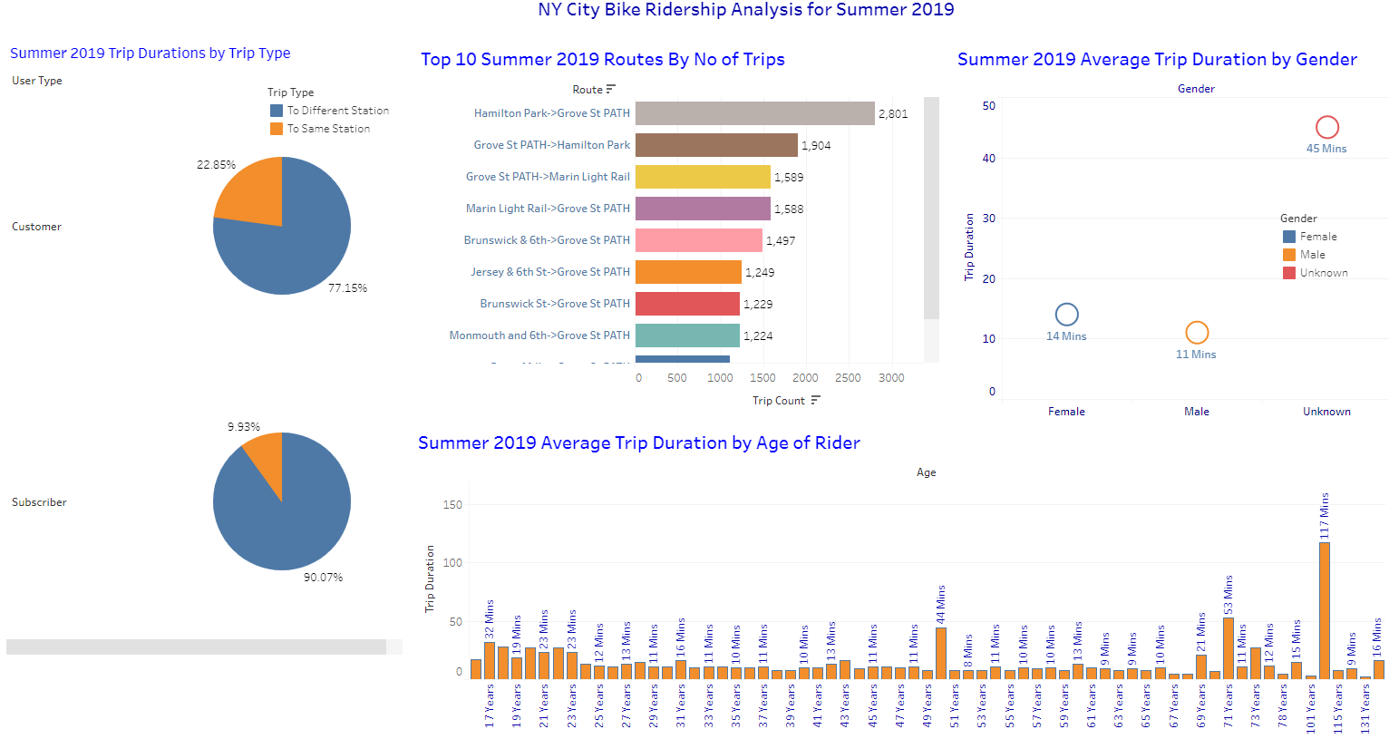
Dashboard # 1

Slide 15
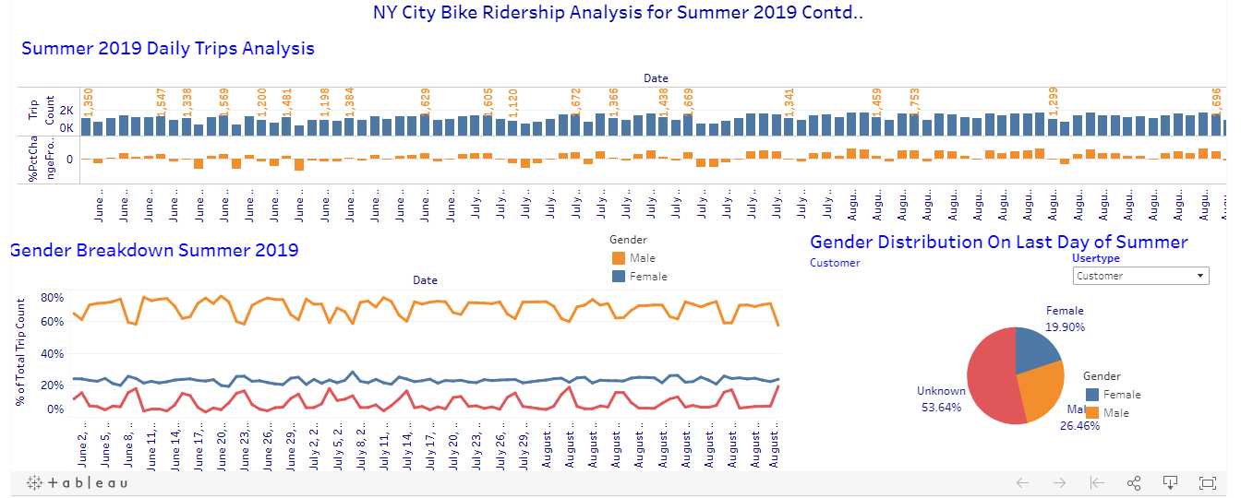
Dashboard # 2

Slide 16
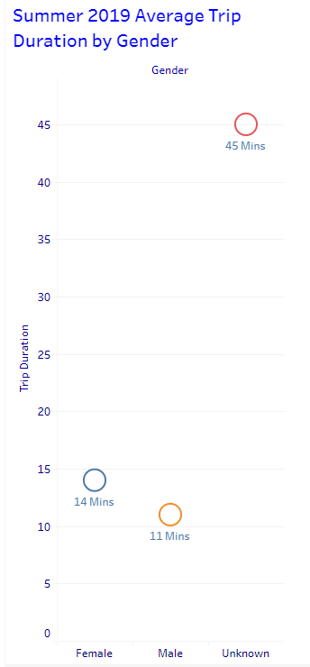

The average bicycle trip duration of males are 11 minutes while that of females are 14 minutes
An unexpected phenomena is the unknown gender having the highest average trip duration of 45 minutes

Slide 17
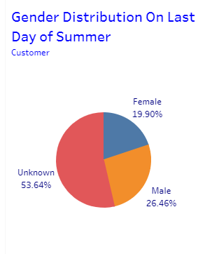
The gender distribution on the last day summer 2019 (which is August 1) is about 26% male and 20% female. An unexpected phenomena is the high percentage of unknown gender, 54%

Slide 18
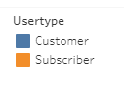
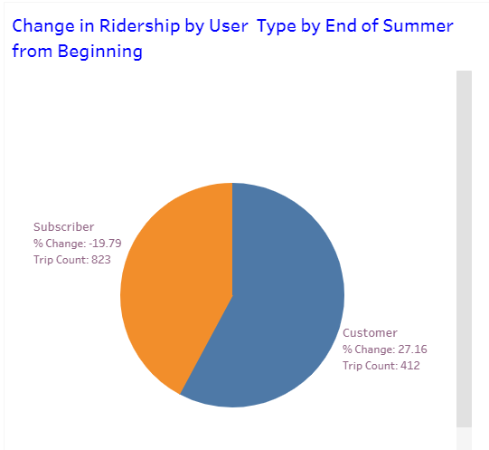
Customers use the bicycles less frequently and usually need the bicycles when they leave a station and need to run a quick errand and usually return the bicycle to the same station when they complete that errand, By the end of the summer, the proportion of these member type would increase relative to the subscriber as the warm weather attracts more casual bike users

